Slide 1


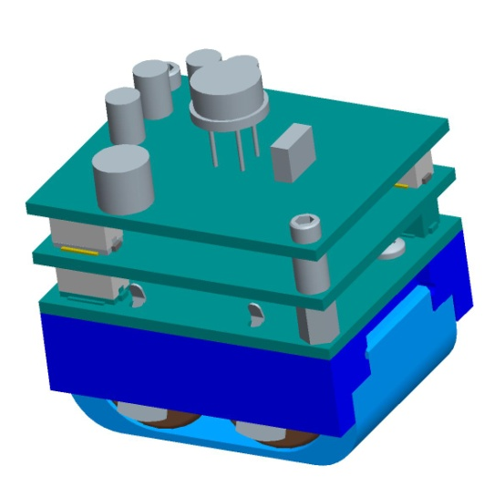
Design of a GPS Capture and Process System for Wireless Networks
Eidy C. Herrera Jacob J. Johns
Hartman D. Rector
Cory Shirts
Kerry R. Wiser

Slide 2
Outline
“Introduction to GPS Tracking System”
Cory Shirts
“Prototype Design and Construction”
Kerry R. Wiser
“Embedded Programming”
Hartman D. Rector
“Transferring GPS Data to a PC”
Jacob J. Johns
“Processing GPS Data”
Eidy C. Herrera

Slide 3
Introduction to GPS Tracking System
Cory Shirts
Notes:
I would like to welcome all of you to our presentation about a GPS tracking system.
Our team included 5 students from the Electrical and Computer Engineering department at the university of Utah, (say each by name).

Slide 4
Introduction
GPS tracking system
Design requirements
Design modifications
Component overview
Notes:
My portion of the presentation will give an overview of the project and introduce its main components. I will first introduce the reasoning behind a GPS tracking system. I will then discuss the design requirements along with the design that the team from the previous year came up with. I will discuss the design that we decided on, there were some modifications that we discovered needed to be introduced. Lastly, I will give a brief introduction to each part of the project.

Slide 5
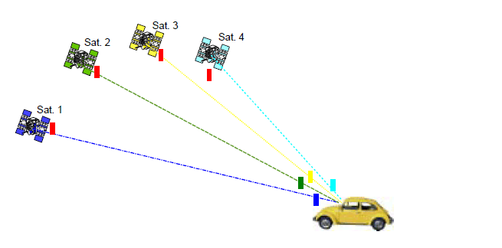
GPS Tracking System
GPS (Global Positioning System)
Consists of constellation of satellites orbiting the earth
Signals from 4 satellites required to determine position
Notes:
Now one may ask, what is GPS? And how does it work? GPS stands for Global Positioning System, it consists of a constellation of satellites, 30 of them was the figure that I found, orbiting the earth. One of the features of this constellation is that at any point on the earth, there are guaranteed to be at least 4 satellites that a receiver would be able to get signals from. This is the number of satellites a GPS receiver needs to calculate its position on the earth.

Slide 6
GPS Tracking System
Typical GPS solution
Cold start (no data) needs about 40 s of data
Applications for location tracking in real time
Internal processing
Notes:
In order for a GPS receiver to calculate one position, it needs 40 seconds of data. The data is processed internally, that is processed with the same machine that gathered the data. After this, the receiver’s position can be tracked in real time, showing exactly where it is as it moves. This allows applications to calculate a position and be accurate within a few meters, and with the more advanced ones, within centimeters.

Slide 7
GPS Tracking System
Drawbacks of typical solution
Power consumption
Data storage
Not for portable devices
Notes:
However, there are parts of this solution that make that make it less compatible with other applications. For example, what if you wanted to track a position over time with a portable device. The large amount of data would require larger amounts of space, and continuously processing that data would require the resources of a processor, which when it is always on would consume large amounts of power. These things make this solution for smaller devices less feasable.

Slide 8
Portable GPS Tracking
Samples
Taken periodically
Taken when needed (detected motion)
Contain only essential data
Data transferred to PC
Post-processing, web service do the rest
Notes:
To help with this, there is a concept of a portable GPS tracking device. To save on power, short GPS samples are taken periodically and only when needed (such as when the device is moved). The samples are later transferred to a PC, where post-processing and a web service fill in the gaps to provide the data needed to calculate a position.
One example of a product that this project was inspired by was from a company called GeoTate. Their device had the ability to be plugged into a camera, and for each picture that was taken, a .2 second long GPS sample was also taken by this device. Later, when the memory was plugged into a computer, an application would lookup the rest of the needed data on an online database that stores GPS satellite info using the collected samples. This would allow for the application to calculate the position on earth where each picture was taken.

Slide 9
Design Requirements
Low power consumption
Run off 2 CR2 batteries (3.3 Volts)
Last for two weeks
Compatibility with Sandia Stack
Size constraints
Interoperability with other
devices in the stack
Sandia Stack
0.3”
0.6”
1.25”
1.5”
Notes:
For this project, we needed to design a device for Sandia Labs that does something similar. It needed to run off of CR2 batteries, commonly used in cameras. We also had some size constraints. It needed to be compatible with the Sandia Stack, a device that is able to stack different chips and be stored for 2 weeks, running each of the devices. An eventual application of our chip would be to plug in our device to the Sandia Stack and then ship it with some cargo, it would then track the whereabouts of the cargo while it was being shipped.

Slide 10
Previous Design
Design from previous team
Processor with Low Power Modes (LPM)
Accelerometer to trigger wakeup
Small flash chip to store small samples
SiGE GPS receiver

Slide 11
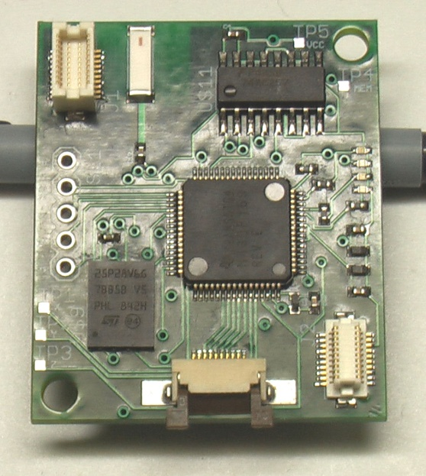
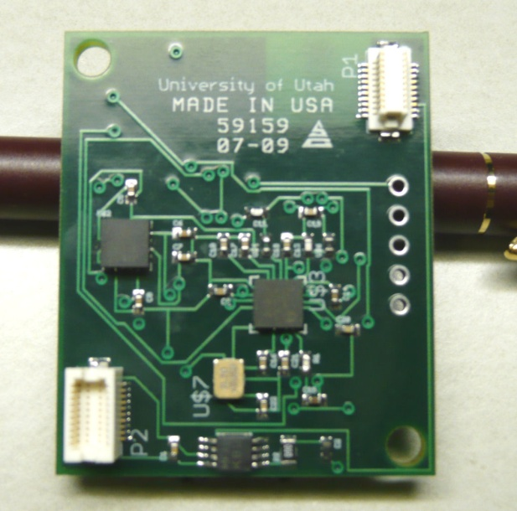
Previous Design
Top Side
Bottom Side

Slide 12
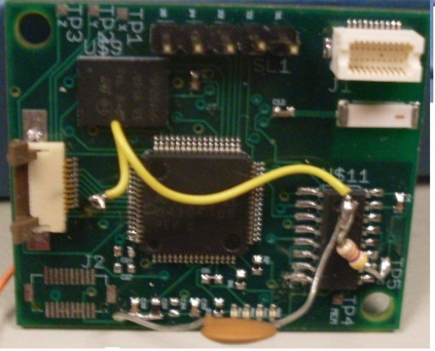
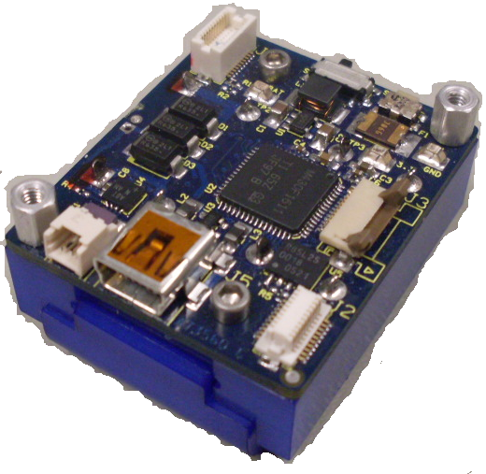
Design Requirements
Changes needed
Broken Components
Difficult to test
Processor was slow
Flash memory was small
From 08-09 Team
Sandia Stack

Slide 13
Design Modifications
Our approach
New, faster low power processor
Bigger flash chips
Newer accelerometer model
Use testable prototypes for development
Sandia Stack

Slide 14
Prototype Design (Kerry)
Eagle CAD for maintaining schematics and manufacturing parts
Some parts were bought
Assembled some, had some made
List of Prototypes
Accelerometer
Flash memory
SiGE GNSS antenna
Multiplexers

Slide 15
Programming Overview
Setup
Get info on bad flash blocks if we don’t already have it
Setup ADC for Accelerometer
Setup external wake-up pin
Main Loop
Enable wake-up pin
Go into LPM3 mode to save power
Interrupt once per second to check for movement
Disable SiGE
Turn off ADC, initialize flash, and enable SiGE
Exit LPM3 if movement or wakeup signal is detected

Slide 16
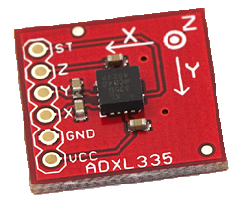
Programming (Cory)
Low Power (LPM3) Code
Interface accelerometer with processor
External wakeup feature
Integration
ADXL335 Accelerometer

Slide 17
Programming (Hartman)
Interface processor with flash chips
Processor’s USB interface
Interface processor with SiGE chip

Slide 18
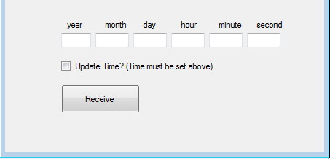
Programming (Jake)
Real Time Clock on processor
For timestamps, narrows online search
PC application to get data from device

Slide 19
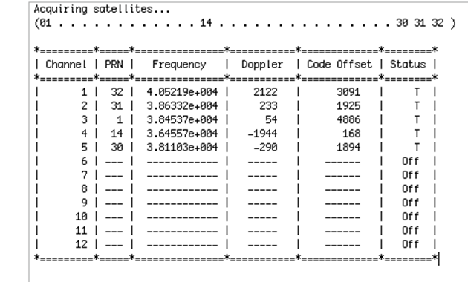
Post-processing (Eidy)
Adapt Matlab code to our project
Generate RINEX files from GPS data
Combine results with online stored data
Sample output from code

Slide 20
Results
Prototypes
Built and tested
Need to test connected system
Programming
In debugging phase
Processing
Reduced amount of data needed to 12 s

Slide 21
Questions?

Slide 22
Prototype design and construction
Kerry R. Wiser

Slide 23
Prototypes
Benefits
Avoid ruining circuit components
Easier to test, debug, and modify
Expedite debugging process

Slide 24
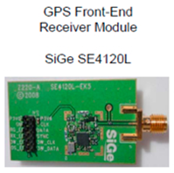
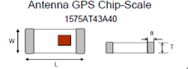
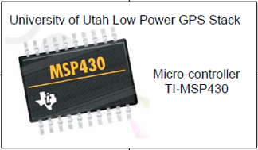
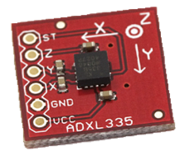
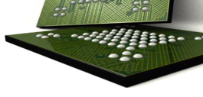
Prototypes
Hardware Overview
Accelerometer
ADXL335
Micron Serial Flash Drive
1Gb MT29F1G01ZACHC
Micron Serial Flash Drive
1Gb MT29F1G01ZACHC
POWER SUPPLY
LM2936

Slide 25
Prototypes
Hardware Overview
Break-out/Test Boards for
Microcontroller
Accelerometer
GPS Radio
GPS Main Board
SiGe Daughter Board
Flash Memory
Multiplexer

Slide 26
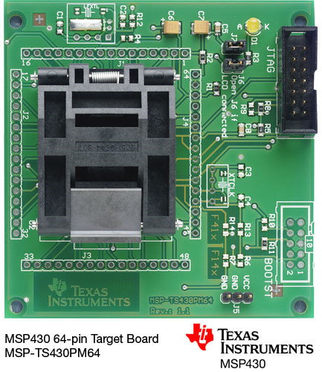
Prototypes
Microcontroller – Previous
[1]

Slide 27
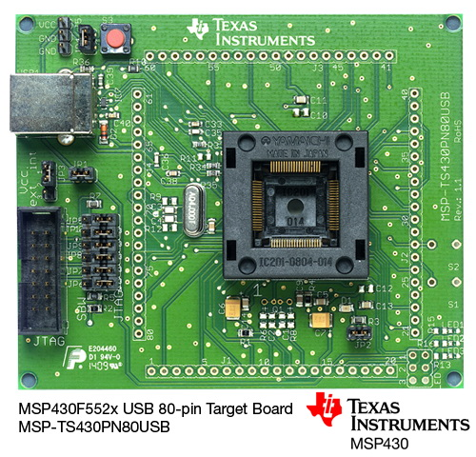
Prototypes
Microcontroller – Current
[2]

Slide 28
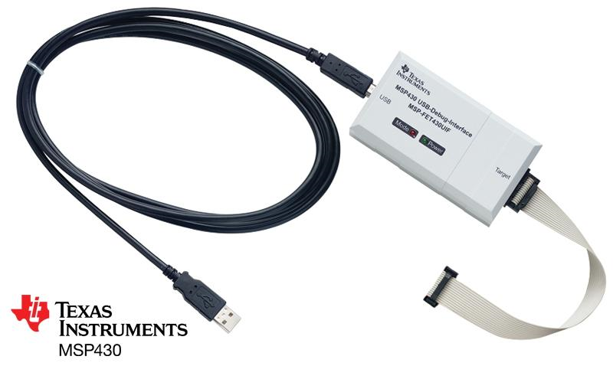
Prototypes
Microcontroller – Debugging Interface
[3]

Slide 29
Prototypes
Accelerometer
[4]

Slide 30
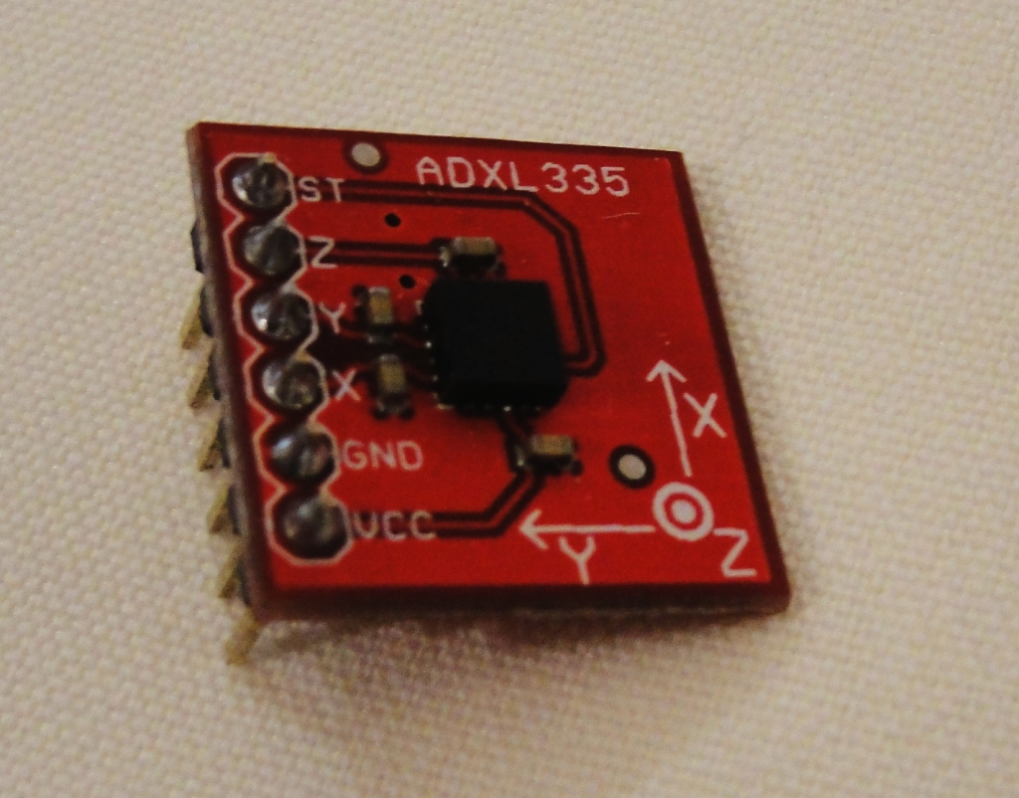
Prototypes
Accelerometer

Slide 31

Prototypes
Flash Memory
63-ball VFBGA
0.8 mm spacing
[5]

Slide 32
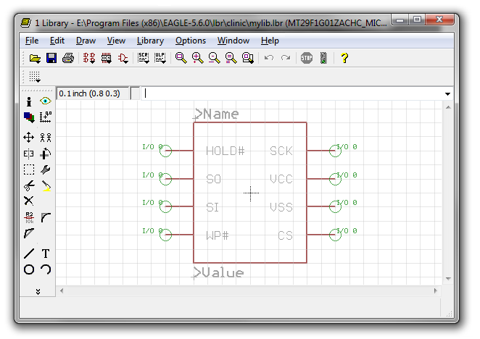
Prototypes
Flash Memory: CAD

Slide 33
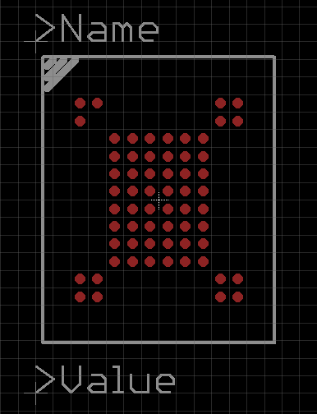
Prototypes
Flash Memory: CAD

Slide 34
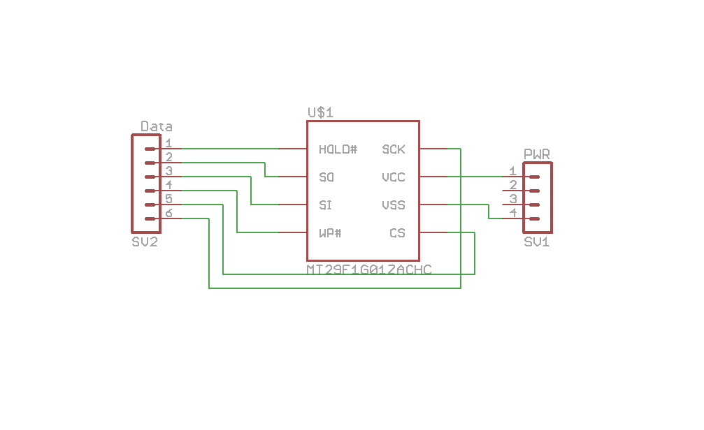
Prototypes
Flash Memory: CAD

Slide 35
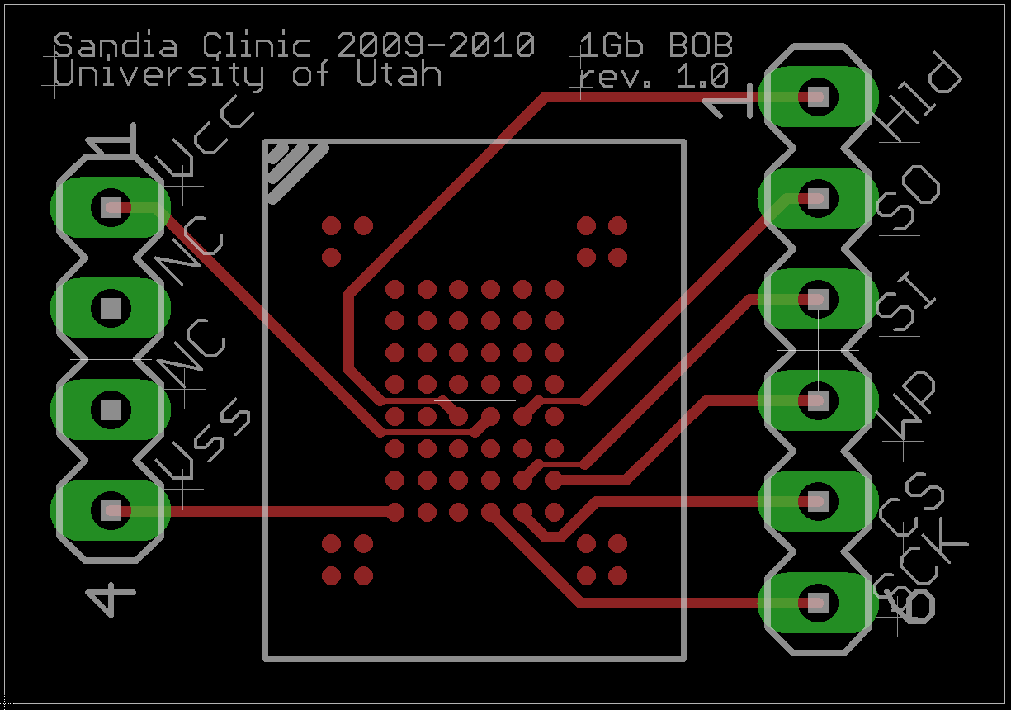
Prototypes
Flash Memory: CAD

Slide 36
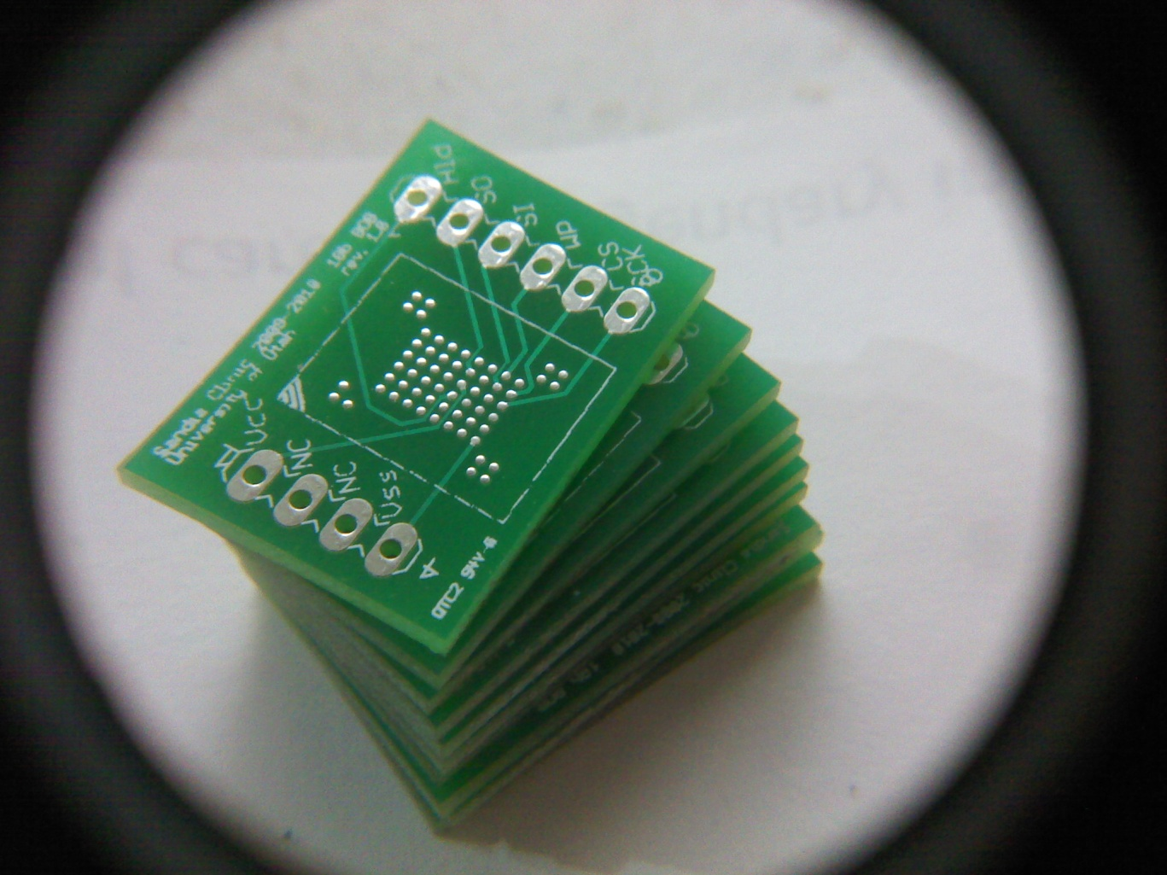
Prototypes
Flash Memory: PCB

Slide 37
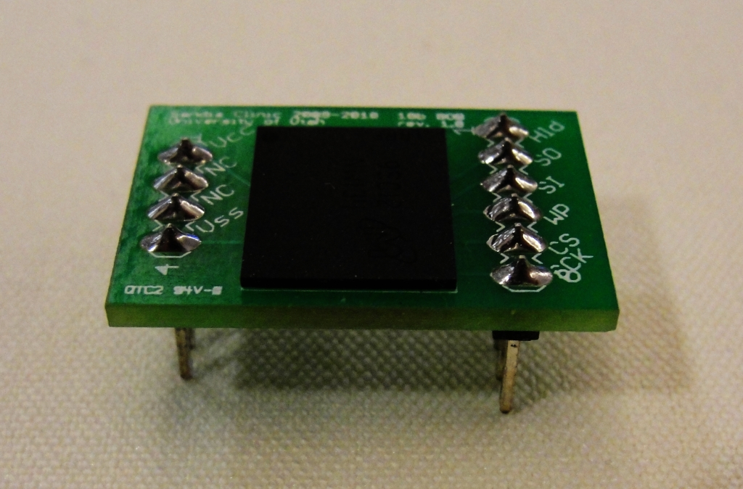
Prototypes
Flash Memory: Assembled

Slide 38
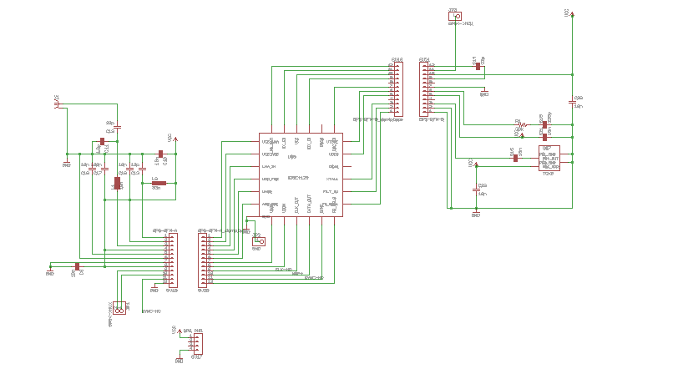
Prototypes
GPS Radio

Slide 39
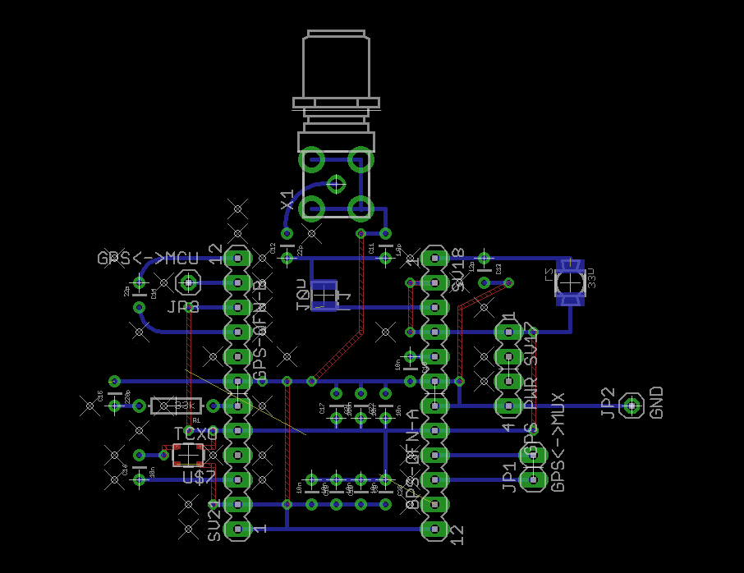
Prototypes
GPS Radio: Main Board

Slide 40
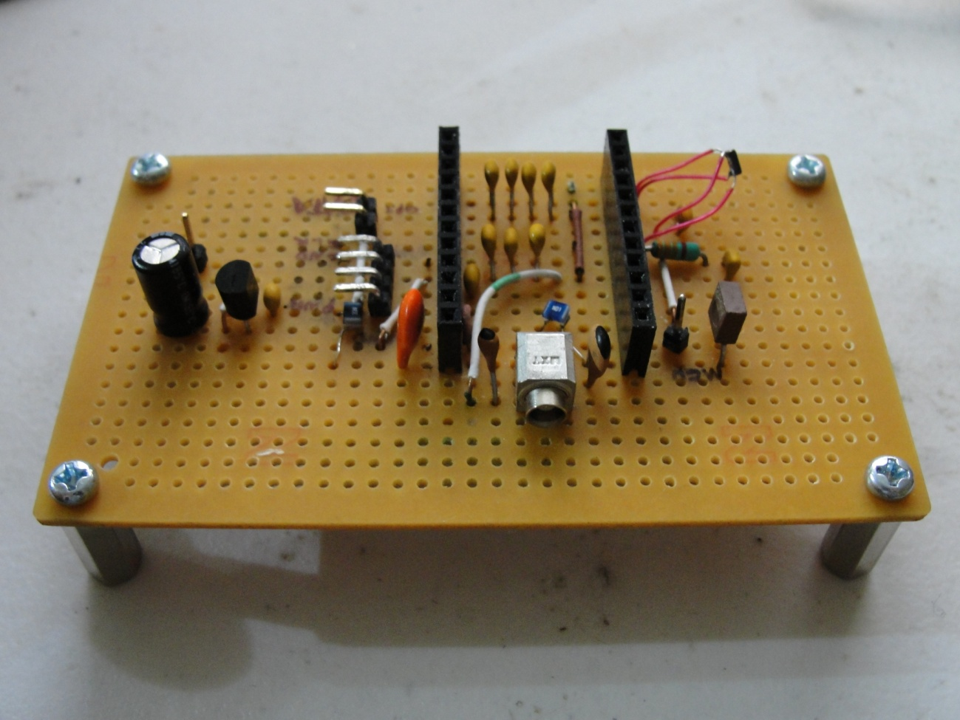
Prototypes
GPS Radio: Main Board

Slide 41
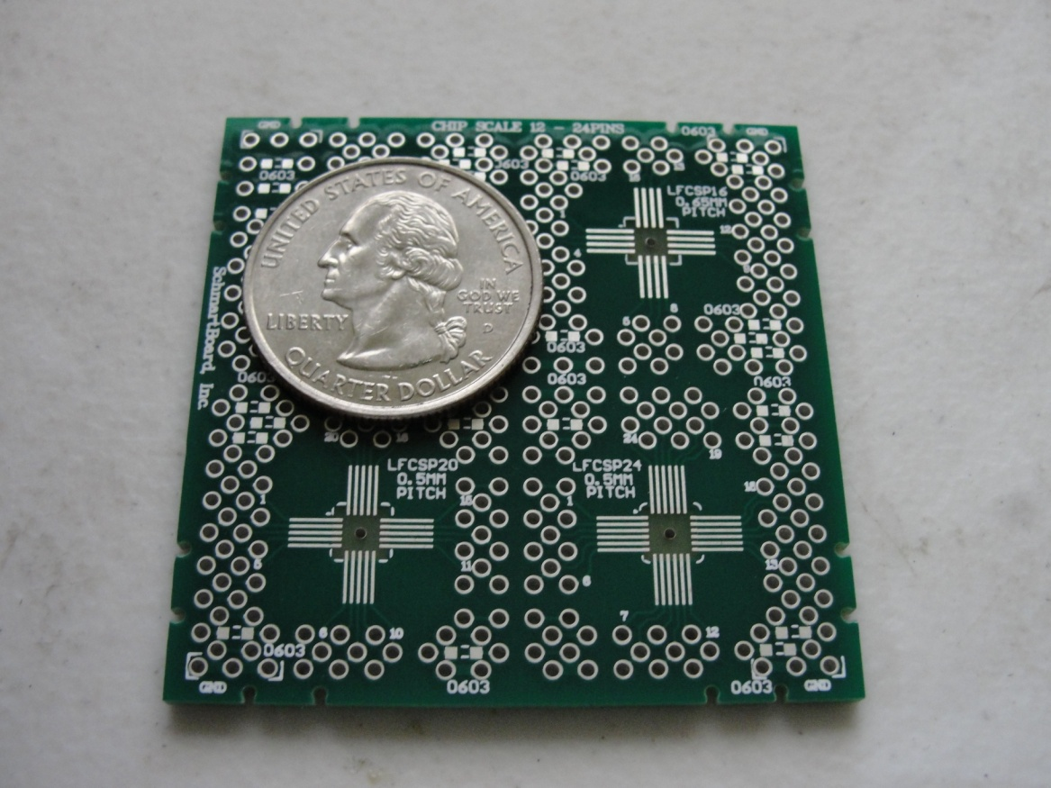
Prototypes
GPS Radio: SiGe Daughter Board

Slide 42
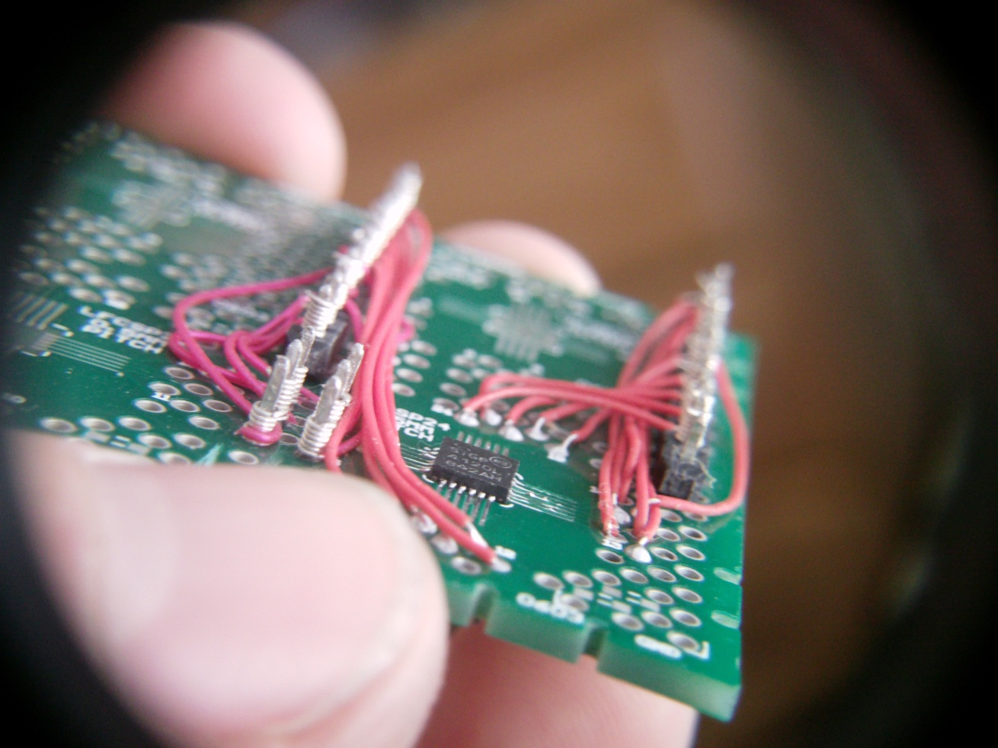
Prototypes
GPS Radio: SiGe Daughter Board

Slide 43
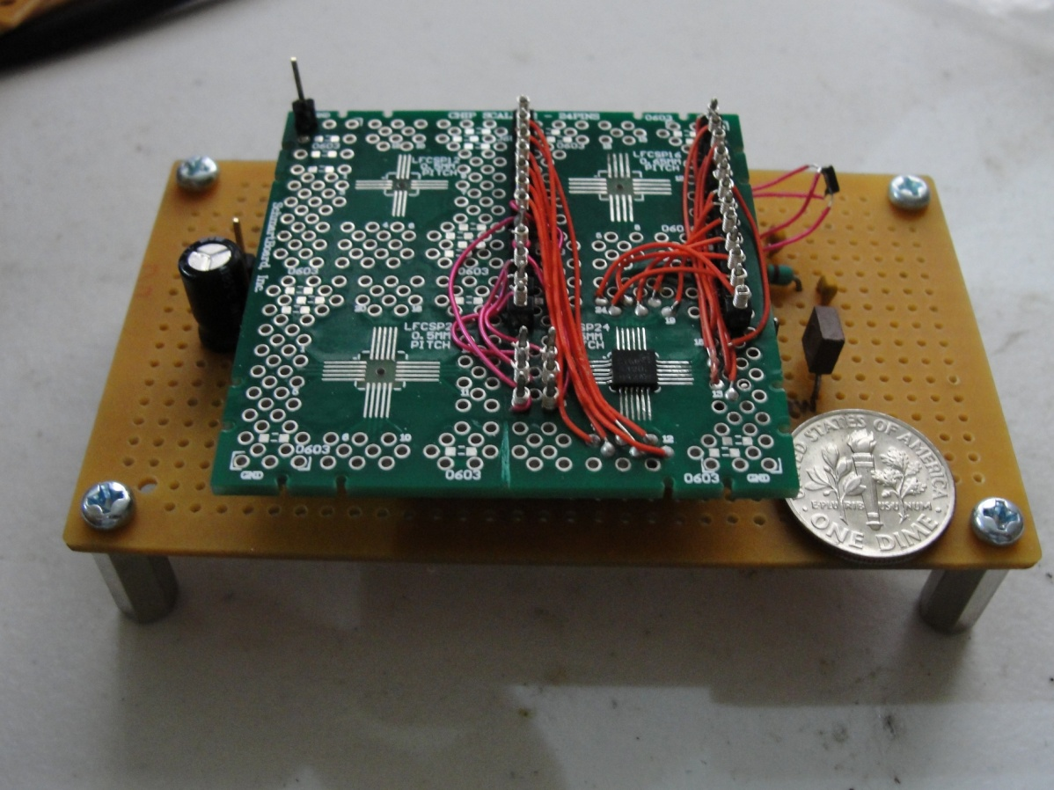
Prototypes
GPS Radio: Adjoined

Slide 44
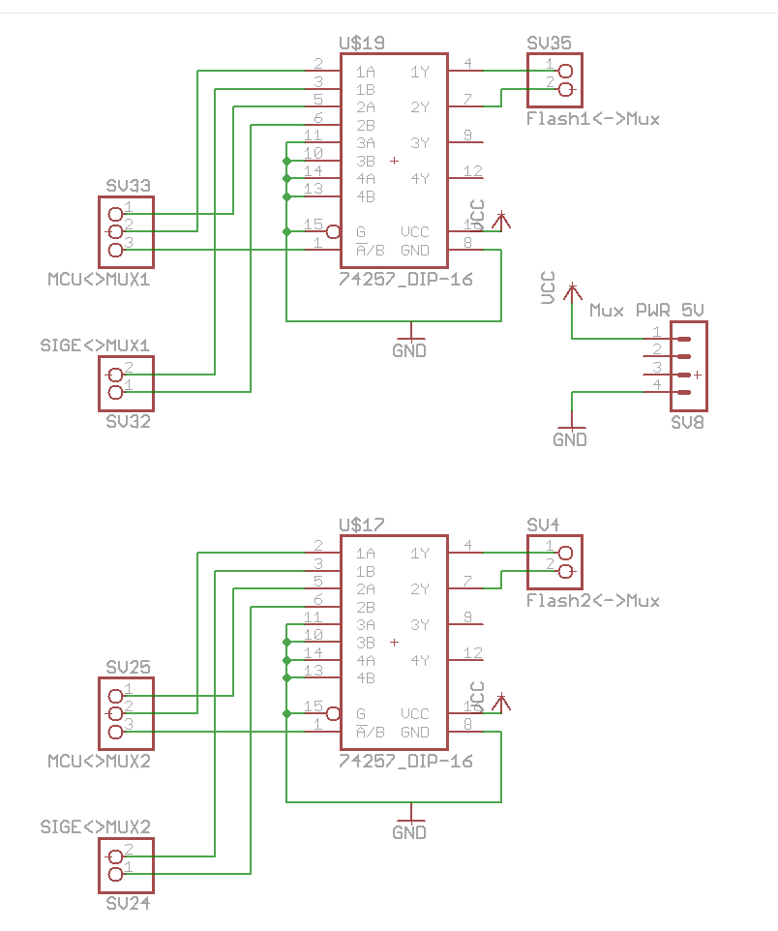
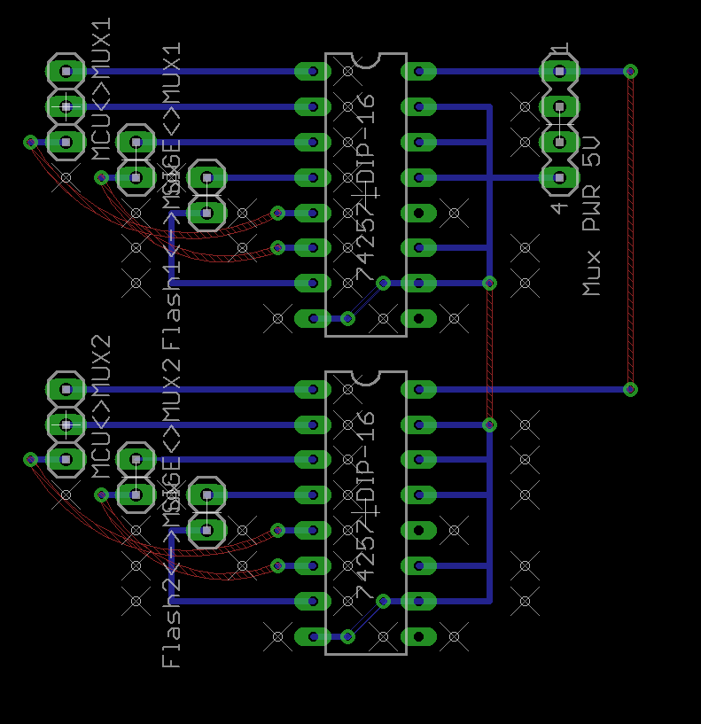
Prototypes
Multiplexer

Slide 45
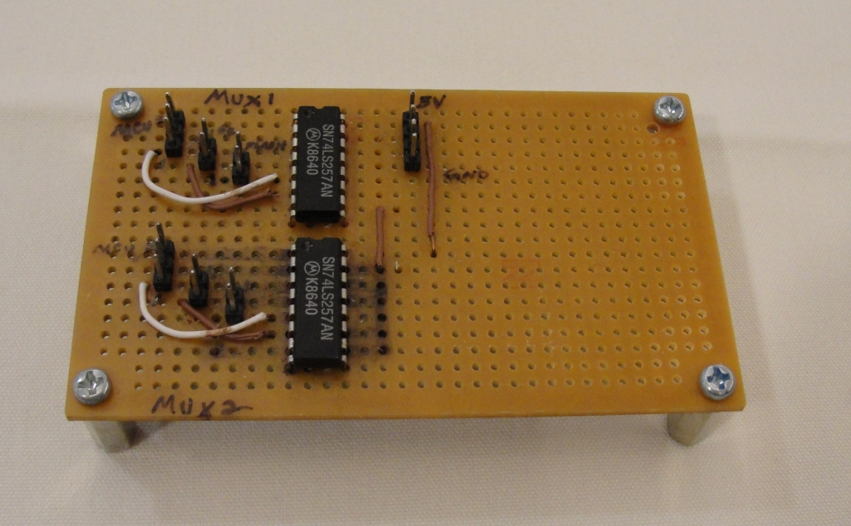
Prototypes
Multiplexer

Slide 46
Prototypes
Budget
Parts | Part#/SKU | Per Item Cost | Quantity | Sub-Total | Form Factor
Breakout Boards:
Accelerometer | SEN-00692 | $ 24.95 | 3 | $ 74.85 | Break-out w/ Pin Header
Real-time clock module | BOB-00099 | $ 19.95 | 3 | $ 59.85 | Break-out w/ Pin Header
ICs:
1Gbit serial NAND flash | MT29F1G01ZACHC-ET:C | $ 6.56 | 10 | $ 65.60 | 63VFBGA
Quad 2-input mux | 74ACT257PC | $ 0.59 | 5 | $ 2.95 | DIP16
SiGe GNSS receiver | SE4120L-R | $ 0.00 | 5 | $ 0.00 | 24QFN
Test board for MSP430F5529 | MSP-TS430PN80USB | $ 75.00 | 1 | $ 75.00
16.368Mhz VCTCXO |  | $ 8.13 | 10 | $ 81.30 | SMD
Misc components:
Stripboard (large) |  | $ 1.95 | 2 | $ 3.90 | 110x94mm
Stripboard (small) |  | $ 0.95 | 10 | $ 9.50 | 94x53mm
MCX connector | WRL-00593 | $ 1.95 | 3 | $ 5.85 | PCB edge mount
Passive components |  | $ 20.00 | 1 | $ 20.00
Pin headers |  | $ 0.75 | 20 | $ 15.00 | Square, .1" pitch, through-hole
Ribbon cables, wire |  | $ 20.00 | 1 | $ 20.00
QFN Schmart board | 202-0016-01 | $ 9.99 | 3 | $ 29.97
Mechanical Bridge (x20) | 920-0003-01 | $ 5.00 | 1 | $ 5.00
2" jumpers and headers |  | $ 5.00 | 2 | $ 10.00
3" jumpers and headers |  | $ 5.00 | 1 | $ 5.00
T.H. Power And Gnd Strip | 201-0100-01 | $ 2.50 | 2 | $ 5.00
M3 nuts and screws 12-pack | STOFFHEX_15MM | $ 2.20 | 4 | $ 8.80
SD/MMC breakout board | BOB-00204 | $ 17.95 | 1 | $ 17.95
Breakaway female pin-header | PRT-00115 | $ 1.50 | 2 | $ 3.00
Flash breakout PCB | custom | $ 15.00 | 10 | $ 150.00 | PCB
Est. shipping/tax/labor
Schmartboard.com |  | $ 15.65 | 1 | $ 15.65
Futurelec.com |  | $ 22.00 | 1 | $ 22.00
SparkFun |  | $ 8.29 | 1 | $ 8.29
avnet.com |  | $ 8.00 | 1 | $ 8.00
Flash breakout PCB Assembly |  | $ 30.00 | 4 | $ 120.00
Total |  |  |  | $ 842.46

Slide 47
Prototypes
Conclusion

Slide 48
Prototypes
Refrences
[1] " MSP430 64-Pin Target board," [Online document], [cited 2010 Mar 31], Available HTTP: http://focus.ti.com/docs/toolsw/folders/print/msp-ts430pm64.html
[2] " MSP430F55xx USB 80-Pin Target board," [Online document], [cited 2010 Mar 31], Available HTTP: http://focus.ti.com/docs/toolsw/folders/print/msp-ts430pn80usb.html
[3] " MSP430 USB Debugging Interface," [Online document], [cited 2010 Mar 31], Available HTTP: http://focus.ti.com/docs/toolsw/folders/print/msp-fet430uif.html
[4] " Triple Axis Accelerometer Breakout - ADXL335," [Online document], [cited 2010 Mar 31], Available HTTP: http://www.sparkfun.com/
[5] " Serial NAND : MT29F1G01ZACHC-ET," [Online document], [cited 2010 Mar 31], Available HTTP: http://www.micron.com/products/partdetail?part=MT29F1G01ZACHC-ET

Slide 49
Questions?

Slide 50
Embedded Programming
Hartman D. Rector

Slide 51
Embedded Software Design
The first time the system is powered on the flash memories are checked for bad blocks and that information is stored in nonvolatile memory.
The microcontroller then sets up the connections to the accelerometer and sets up interrupts that allow it to take a sample if movement is detected. Interrupts are also set up that cause a GPS sample to be taken upon a signal from the Sandia stack.
An interrupt is set up that allows transfer of the data stored in flash to a PC for processing.
The CPU then enters low power mode and waits for a signal to take a sample or transfer data to a PC.
Most of the work for this project involves interfacing the microcontroller with the various hardware components.

Slide 52
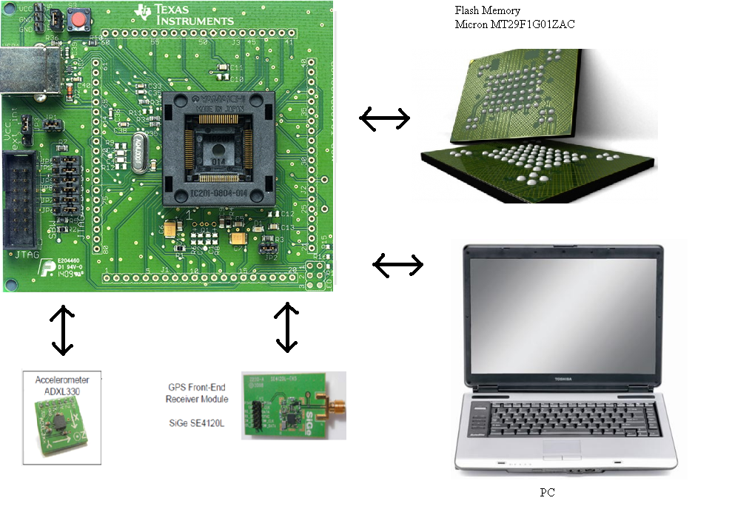
Interfacing

Slide 53
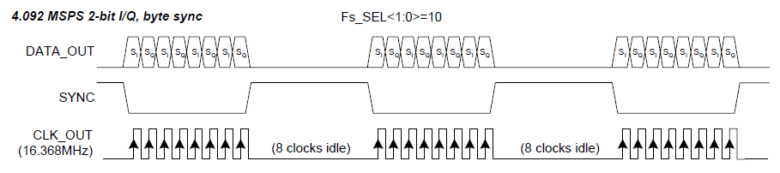
Interfacing With Flash Memory
Capture .2 to 15 seconds of uninterrupted data from GPS front-end, which has a speed of 16 Mhz
Consume as little power as possible
GPS Front-End Output

Slide 54
Flash Memory Specs
Commands must be sent to the Flash memory to set up a write operation
A single page of data can be streamed directly into the flash memory at up to 50 Mhz
A record command must be issued and the data must be flashed during which time data cannot be captured
The next write operation can begin

Slide 55
Design Decisions
To keep power consumption as low as possible the slowest possible microcontroller should be used.
To avoid interruptions in the data, two flash memories are used. Data is streamed into one while the other is flashed.
Each flash memory will have a multiplexer
Because data is being captured from the front end directly custom software must be written to drive the flash memories

Slide 56
Old Flash memory
Original design problems
Numonyx M25P128 flash memory
Page Size 256 bytes
Time to program page 2.5 ms
Takes .3 ms to shift data into flash
This leaves a 2.2 ms gap in data every .3 ms
Matlab program requires 11ms of uninterrupted signal just to do acquisition

Slide 57
Our Memory Solution
Micron MT29F1G01ZAC 1Gb flash memories
page size = 2112 bytes
Time to fill page with data from SiGE: 2000 us
Time to program page = 900 us max.
This leaves 1100 us to set up next write operation
Total memory size = 2 Gb or 130 sec of data

Slide 58
Setup ports both muxes = MCU
.

Slide 59
.
Send reset and write commands

Slide 60
.
Switch mux flash 1 = front end

Slide 61
.
Wait for page to fill

Slide 62
.
Loop begins here

Slide 63
.
Toggle both muxes with xor

Slide 64
.
Write stop bit

Slide 65
.
Send program execute command

Slide 66
.
Wait for flash to program

Slide 67
.
Send write command

Slide 68
.
Wait for page to fill

Slide 69
.
Goto loop

Slide 70
.
Toggle both muxes with xor

Slide 71
.
Write stop bit

Slide 72
.
Send program execute command

Slide 73
Possible Flash Design Improvements
Microprocessor runs at 25 MHz to get the project up and running, this can be lowered
Current design uses busy loop to wait for the flash to fill with data, this can be modified to put the CPU into low power mode while the data is being collected
Design could be optimized further by using the DMA

Slide 74
Accelerometer
Our current design samples the accelerometer on startup to establish a threshold for movement.
When the threshold is exceeded the CPU is taken out of low power mode and a GPS sample is taken.
After the sample is taken the CPU goes back into low power mode.
ADXL335 Accelerometer

Slide 75
GPS Front-End
We are using the SiGe SE4120L GNSS Receiver
The receiver can be put into standby mode when it is not needed consuming less than 10 u amps of current.
The output is streamed directly into flash memory for processing at a later time
The following code is used to make sure we start recording at the beginning of a sample
while(P2IN&BIT0); //wait for it to go low while(!(P2IN&BIT0)); //wait for it to go high P1OUT |= BIT4; //mux1 = sige

Slide 76
Questions?

Slide 77
Transferring GPS Data to a PC
Jacob J. Johns

Slide 78
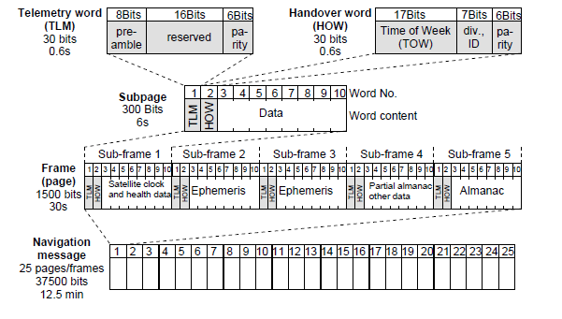
Real Time Clock (RTC)
Importance
Problems
Solution
Functions
Figure from: Essentials of Satellite Navigation GNSS Technology: page 31

Slide 79
Serial Communication
Why serial
Design
Start byte (0x8C)
Send byte (0x10)
Acknowledge byte (0xA5)
Error byte (0x33)
Checksum (CRC8)

Slide 80
Serial Communication
User interface design for serial
The switch to USB

Slide 81
USB
Example code
Sets up virtual COM port to use with hyperterminal
How it works
Select capture text in hyperterminal
Specify file to save to
Send GETDATA command in hyperterminal
Select capture text -> stop in hyperterminal

Slide 82
USB
In progress
File format
Matlab
Post processing
User interface

Slide 83
Questions?

Slide 84
Processing GPS Data
Eidy C. Herrera

Slide 85
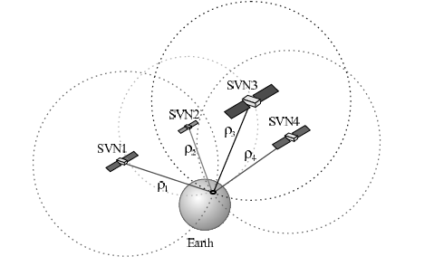
Post-Processing GPS Data
Four satellites required
Latitude
Longitude
Altitude
Time offset

Slide 86
Parameters Needed
Pseudoranges
Distance between the satellites and the receiver
Ephemeris data
Provides the satellites positions at any specific time

Slide 87
The Issue
Existing Matlab software
Need 37 s of GPS data (over 600 MB)
Lengthy tracking process (30 minutes)
Post-processing needs to be accomplished with a smaller sample

Slide 88
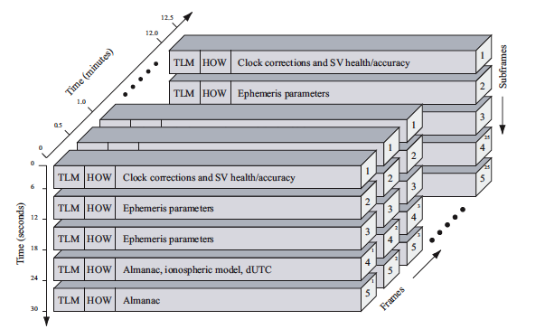
GPS Navigation Data Structure

Slide 89
Solution
New approach to process small data: integrating incomplete sample with stored GPS ephemerides
Use Matlab
Pseudoranges
Time of the week (TOW)
Acquire ephemeris data online
Combine records to get coordinates

Slide 90
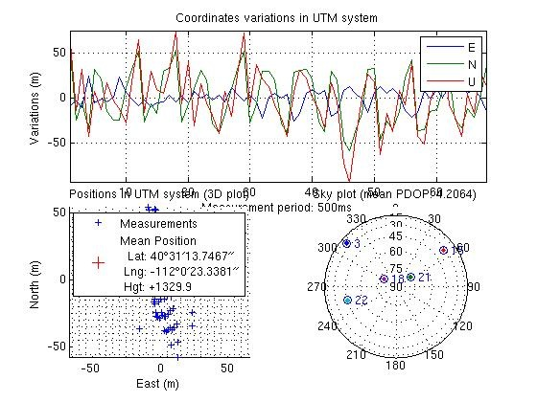
Verifying Matlab Code
Acquisition
Tracking
Position Solution
Notes:
The Matlab code does the acquisition, tracking, and position solution in the same program.

Slide 91
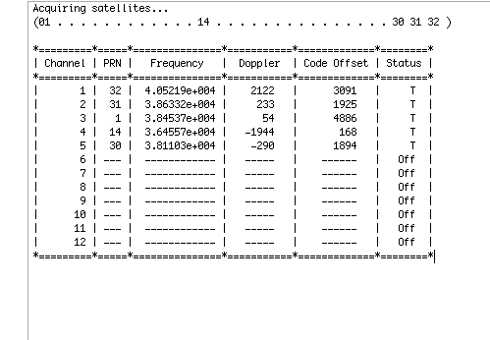
Using Matlab
Create a function to extract the desired length of data
Perform acquisition

Slide 92
Using Matlab
Reduce tracking time from 30 to 3 minutes
Omit ephemeris decoding
Compute valid pseudoranges
Travel time from the satellite to receiver multiplied by the speed of light
Obtain Time Of the Week

Slide 93
Creating a RINEX File
Receiver Independent Exchange Format
Pseudoranges & TOW
TOW UTC
105636 s = 29 hours 20 minutes & 36 s
Observations type
Using Text Editor
Strict format

Slide 94
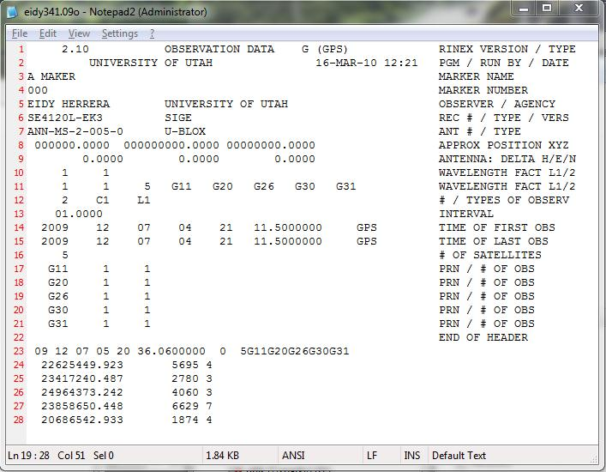
Creating a RINEX File

Slide 95
Obtaining Ephemeris Data
International GNSS Service (IGS) website
Find valid navigation RINEX file based on date and time of capture
File name format:
namedddh.yyn
2-digit year
letter for hour( a-x)
day of the year (1-366)

Slide 96
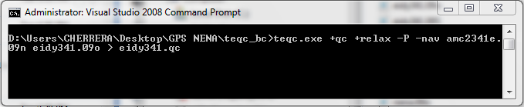
Obtaining Coordinates
Combine observable RINEX file created with navigation RINEX file found online
Teqc (toolkit for GPS data)

Slide 97
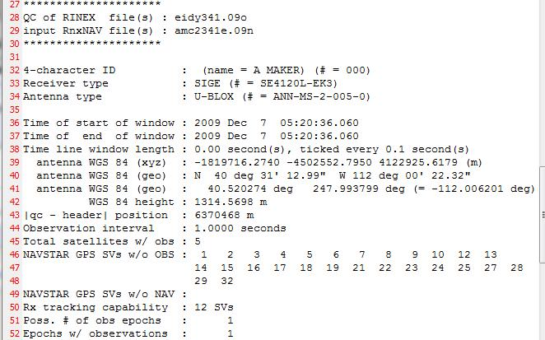
Obtaining Coordinates

Slide 98
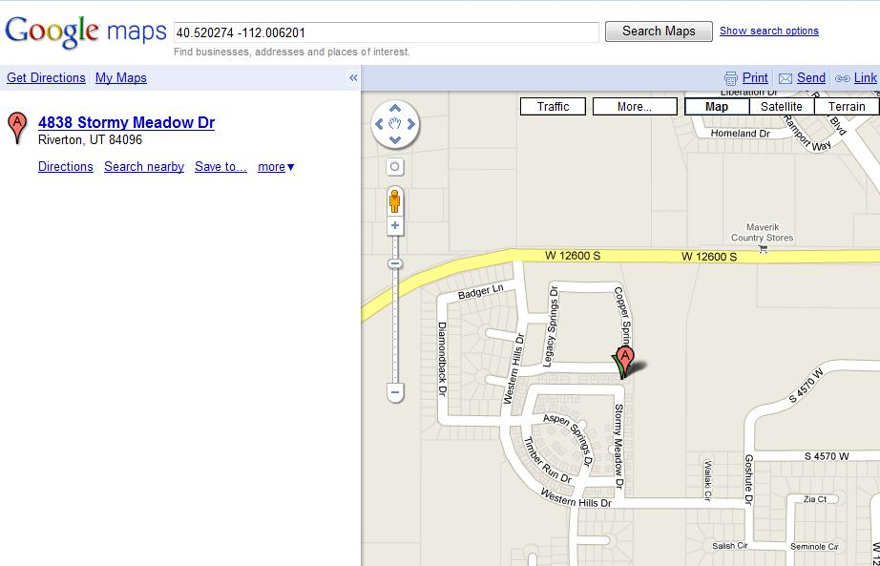
Mapping Coordinates
Google maps

Slide 99
Questions?

Slide 100
References
U-blox AG, “Essentials of Satellite Navigation,” Compendium, Apr. 26,2007.
K. Borre, D. M. Akos, N Bertelsen, P. Rinder, and S. H. Jensen, A Software-Defined GPS and Galileo Receiver: A Single-Frequency Approach (Applied and Numerical Harmonic Analysis). Boston, MA: Birkhäuser 2007.
RINEX: The Receiver Independent Exchange Format Version 2.10 10 Dec. 2007. 01 Mar. 2010 <http://igscb.jpl.nasa.gov/igscb/data/format/rinex210.txt>.
IGS Data 07 Mar. 2005. 01 Feb. 2010 <http://igscb.jpl.nasa.gov/components/data.html>.
TEQC — The Toolkit for GPS/GLONASS/Galileo/SBAS Data 17 Mar. 2010. 03 Mar. 2010
<http://facility.unavco.org/software/teqc/teqc.html>.

